Slide 1
MSBD5013 Final Project Presentation
M5 Forecasting: Accuracy & Uncertainty
Group 4
LU Fei 20797386
XIONG Yi 20787642
ZHENG Hao 20797594

Slide 2
Introduction
/01
About
M5 Forecasting：Accuracy & Uncertainty

Slide 3

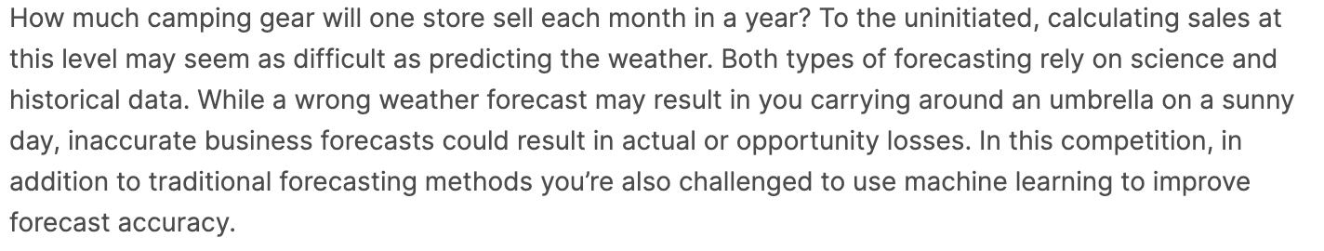
Background
Walmart Sales prediction
Can be seen as a time series prediction. Worth studying.
Need historical data. Need Current features.

Slide 4
Problem Definition
Two parts of the M5 Forecasting
Accuracy
Uncertainty
To predict each item respectively.
To predict sales with Hierarchical features.
Point estimation.
Quantile estimation.
Have sales data from
2011-01-29 to 2016-05-22
Need to predict next
28 days’ sales.

Slide 5
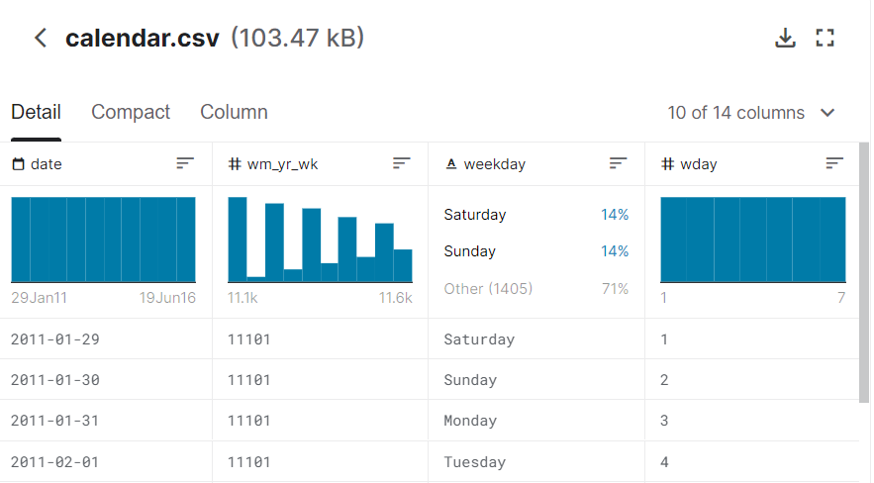
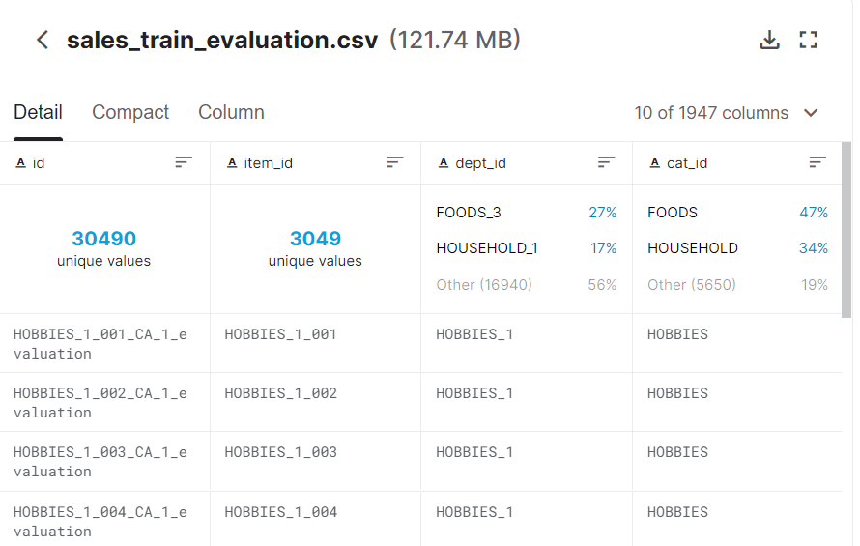
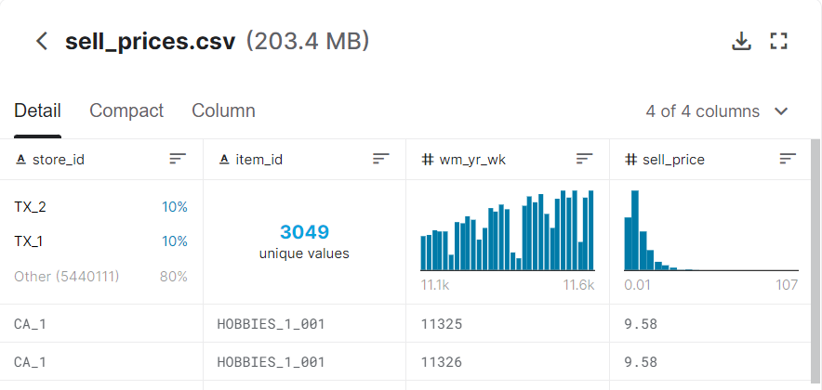
Dataset Description
· wm_yr_wk
· weekday
· snapday
· eventday
· States
· Department
· Category
· Items
· Sales from day_1 to d_1941
· wm_yr_wk
· prices

Slide 6
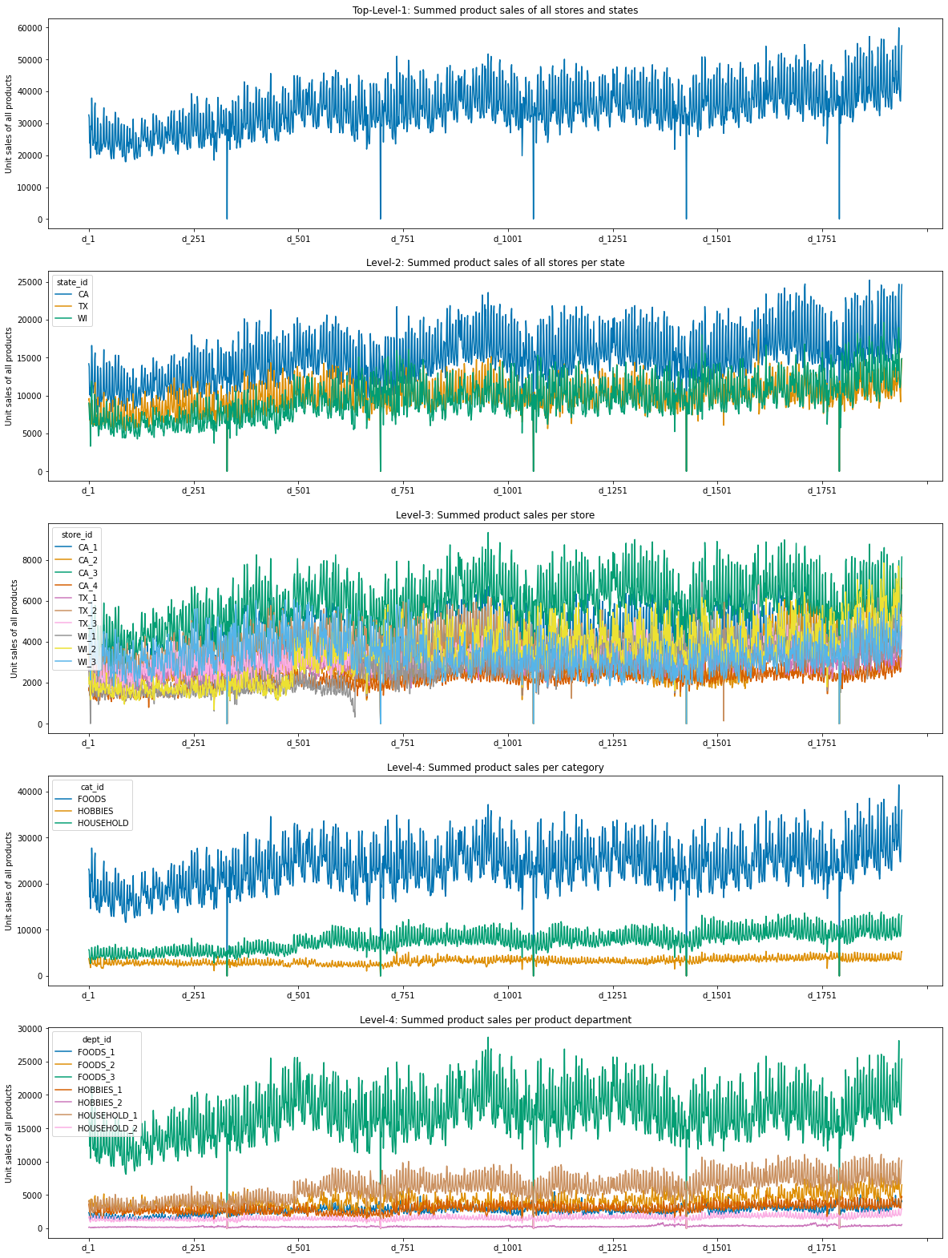
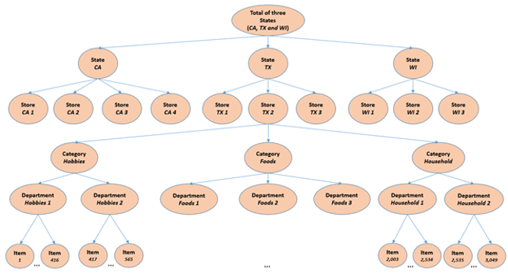
Dataset Visualization: Hierarchy
·12 hierarchical levels
· CA / CA_3 / Food_3
· sales most.

Slide 7
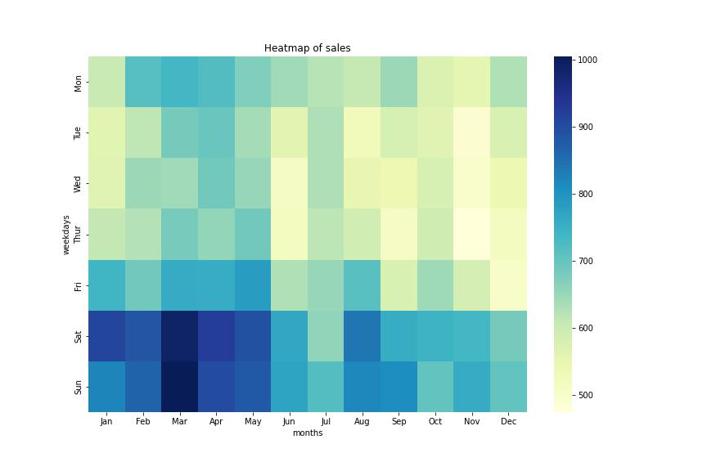
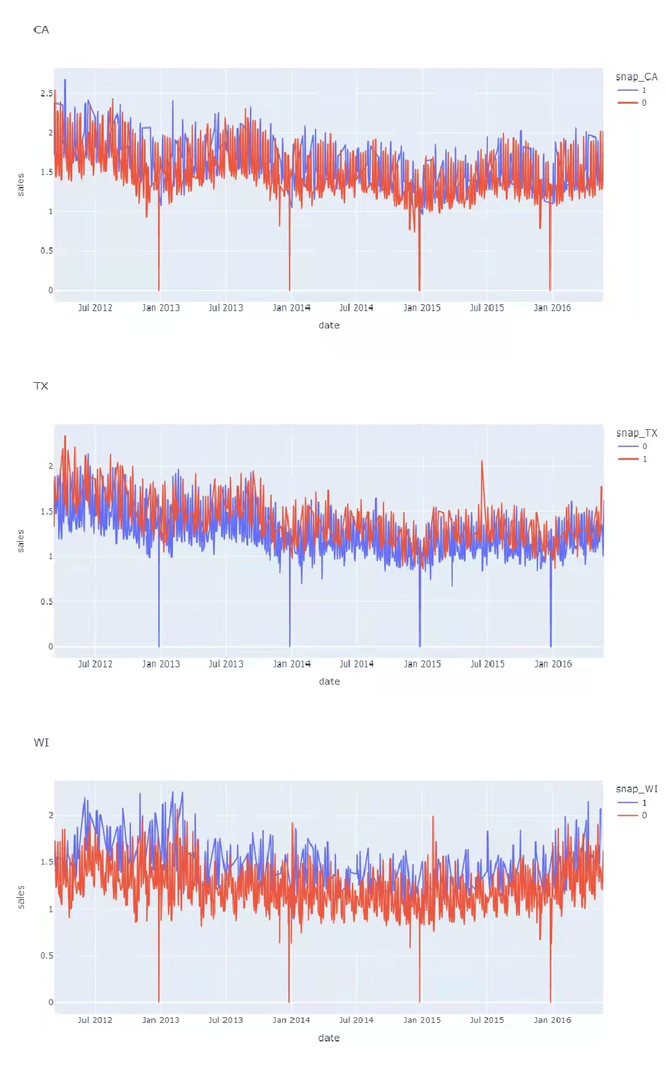
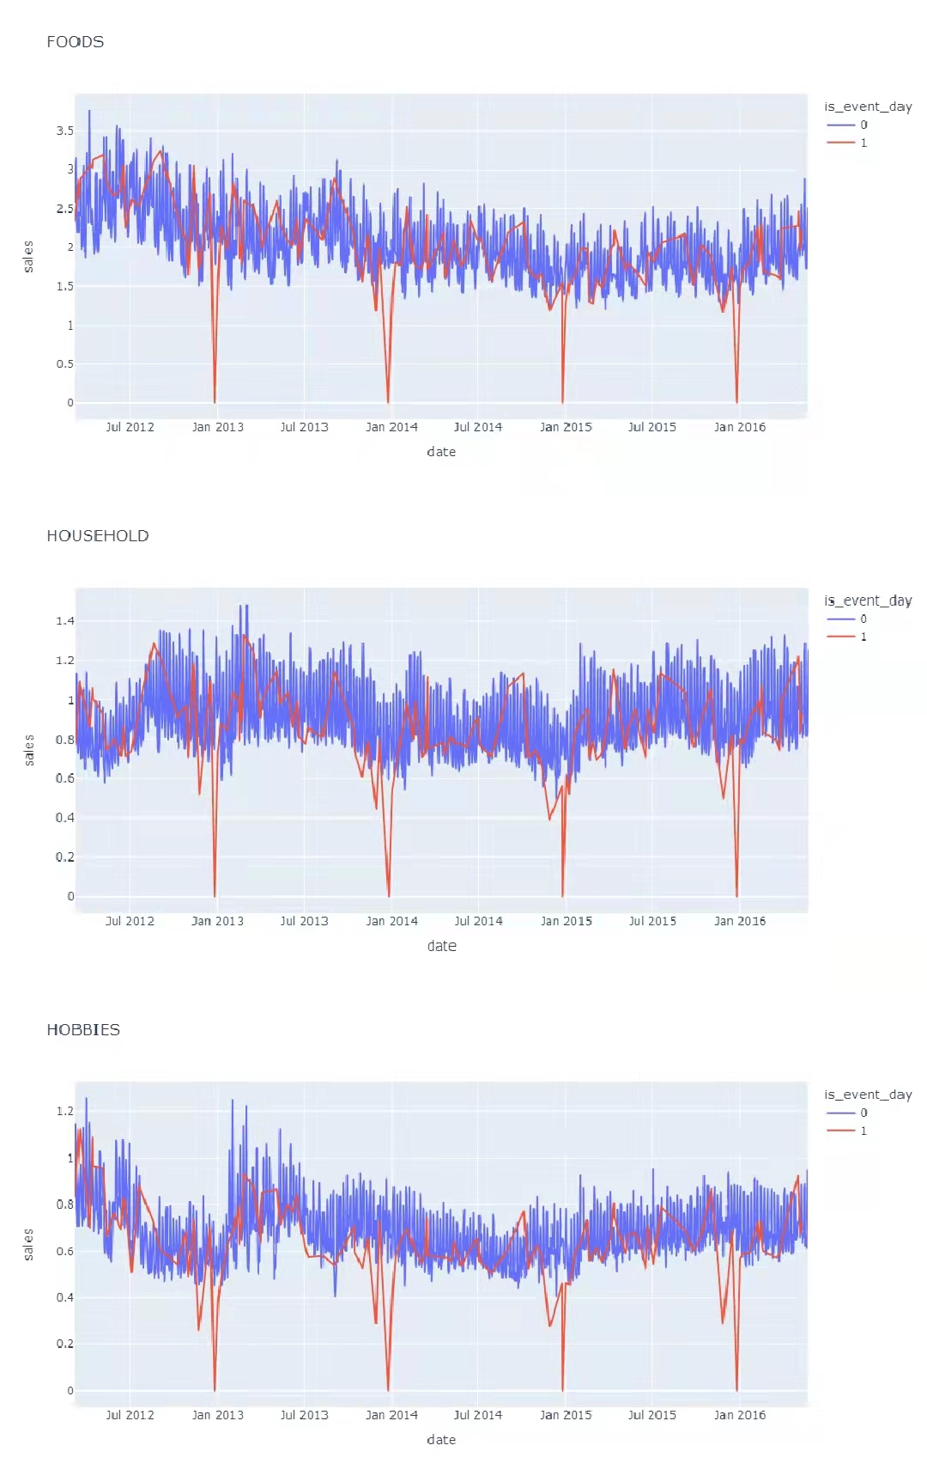
Dataset Visualization: Periodic Features
Snap days
Monthly and weekly days
Event days

Slide 8

Data Preprocessing
Change
Groupby
Average
The data type of every numerical data, nearly half of memory resources are reduced.
To make the submission files,
For each quantile,
It needs 42840 rows.
Values just before or after
these 0 values
and
Fill in the mean values
……
Memory usage reduction
Hierarchy aggregation
Missing values

Slide 9
Method and result of Accuracy
/02
About
M5 Forecasting：Accuracy & Uncertainty
Notes:
Now, let me introduce the method and result of accuracy part in our project.

Slide 10
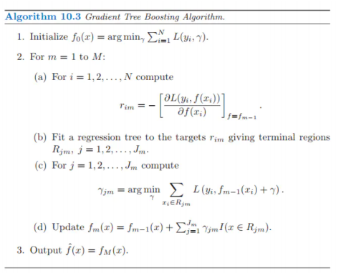
LightGBM
Since the goal of this project is to predict the future sales and there are many features showing impact
to the sales, we choose LightGBM, a powerful regression model, to train this large amount of data and
do the prediction.
GBDT
Improvement from GBDT
LightGBM
Gradient-based One-Side Sampling (GOSS)
Exclusive Feature Bundling (EFB)
Notes:
Since the goal of this project is to predict the future sales and there are many features showing impact to the sales, we choose LightGBM, a powerful regression model, to train this large amount of data and do the prediction.
LightGBM is an improved and faster version of GBDT. GBDT’s code is shown as figure.
On GBDT’s basis, LightGBM use GOSS to obtain more accurate results, and use EFB to minimize the conflict ratio.

Slide 11
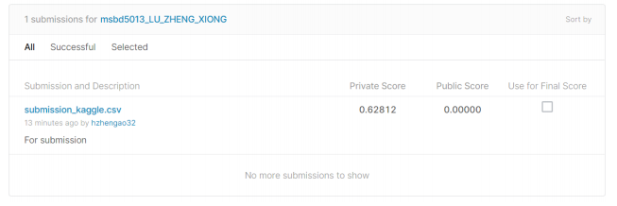
Model and Result
In the actual model training and testing, in order to predict the sales data from d_1942 to d_1969, we use data from d_1 to d_1941, which are in file sales_train_evaluation.csv, and put them into the model for training.
The evaluation is based on the Weighted Root Mean Squared Scaled Error (RMSSE) between the
true value and prediction value. We used the trained model to predict the sales on d_1942 - d_1969.
Notes:
In the actual model training and testing, in order to predict the sales data from d_1942 to d_1969, we use data from d_1 to d_1941,and put them into the model for training.
The evaluation is based on the RMSSE between the true value and prediction value. Our final private score is 0.62812.

Slide 12
Methods of Uncertainty
/03
About
M5 Forecasting：Accuracy & Uncertainty
Notes:
Now, it’s time to introduce the methods of uncertainty part in our project.

Slide 13
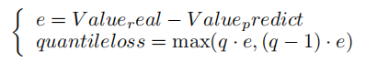
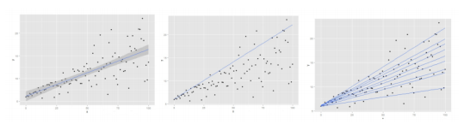
Quantile Regression
Regression analysis
Quantile Regression
The basic idea of Regression analysis is to find a function to fit the training data as precise as possible, and then use the function to do some predictions. The parameters adjusting process is usually realized by minimizing Mean Squared Error as the loss function.
The quantile loss differs depending on different quantile, for higher quantiles, more negative errors are penalized and for lower quantiles, more positive errors are penalized. And the quantile loss function is:
All the regression functions mentioned above are essentially a conditional expectation function. Under the condition that x is equal to a certain value, find the expectation of Y according to the data. But more often, we don’t want to just study the expectation of Y, but also to explore the complete distribution of Y, or maybe in some cases, we prefer to know a quantile of Y
All the regression functions mentioned above are essentially a conditional expectation function. Under the condition that x is equal to a certain value, find the expectation of Y according to the data. But more often, we don’t want to just study the expectation of Y, but also to explore the complete distribution of Y, or maybe in some cases, we prefer to know a quantile of Y
According to the M5 participants’ guide, we are asked to provide the median, and the 50%, 67%, 95%, and 99% prediction intervals, so the quantiles are: 0.005, 0.025, 0.165, 0.25, 0.5, 0.75, 0.835, 0.975, and 0.995.
Notes:
All the regression analysis functions mentioned are essentially a conditional expectation function. But more often, we don’t want to just study the expectation of Y, but also to explore the complete distribution of Y, or maybe in some cases, we prefer to know a quantile of Y.
The quantile loss differs depending on different quantile, for higher quantiles, more negative errors are penalized and for lower quantiles, more positive errors are penalized.

Slide 14
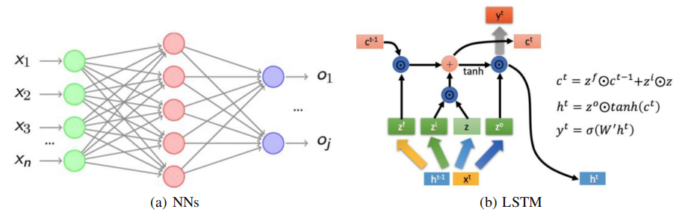
NNs and LSTM
Artificial neural network is an algorithmic mathematical model that imitates the behavior characteristics of animal neural network and carries out distributed parallel information processing. This kind of network depends on the complexity of the system, and achieves the purpose of processing information by adjusting the interconnected relationship between a large number of internal nodes.
When it comes to data with time series properties, we sometimes choose to use LSTM model. LSTM is a special RNN, which is mainly used to solve the problems of gradient disappearance and gradient explosion in the process of long sequence training. In short, compared with ordinary RNN, LSTM can perform better in longer sequences. The specific structure is as figure.
Notes:
Due to the time periodic data, we consider using Artificial neural network and LSTM. Their general structure is shown in the figure.

Slide 15
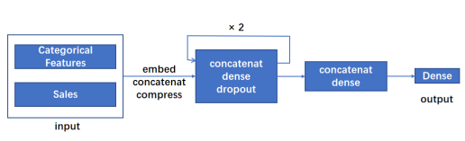
NNs with Quantile Regression
We consider directly using the basic neural network to predict the future sales situation and make the uncertainty estimates.
For quantitative regression, we set a special loss function, in which the quantiles are 0.005, 0.025, 0.165, 0.250, 0.500, 0.750, 0.835, 0.975 and 0.995 respectively.
We used file sales_train_evaluation.csv for training and cross validation. We input the preprocessed training data into the model for training. Among them, each line of training data includes sales data information under a specific hierarchy, including store commodity information, date information, sales, etc. Then, for different quantiles, we use the trained model to predict respectively and save it to the file submission.csv.
Notes:
We consider directly using the basic neural network to predict the future sales situation and make the uncertainty estimates first.
For quantile regression, we set a special loss function.
We input the preprocessed training data into the model for training. Among them, each line of training data includes sales data information under a specific hierarchy. Then, for different quantiles, we use the trained model to predict respectively and save it to the submission file.

Slide 16
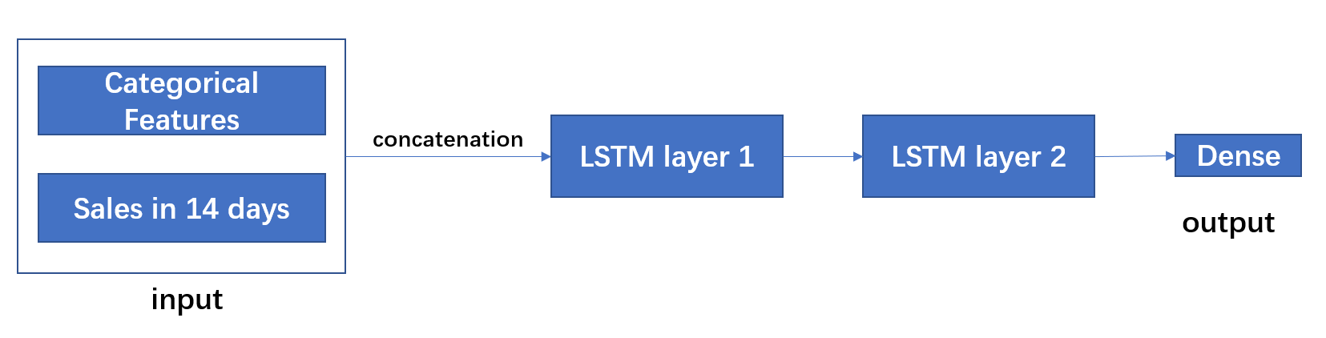
LSTM with Quantile Regression
Training set: (one hierarchy)
Sales
 | d_1 | d_2 | …… | d_14 | d_15 | d_16 | …… | d_1913
sample 1
sample 2
……
input
output
input
output
input
output
1899 samples
Calendar attributes
 | d_1 | d_2 | …… | d_14 | d_15 | d_16 | …… | d_1913
W_day
Event
……
Input
sample1
Input
sample2
Model structure:

Slide 17
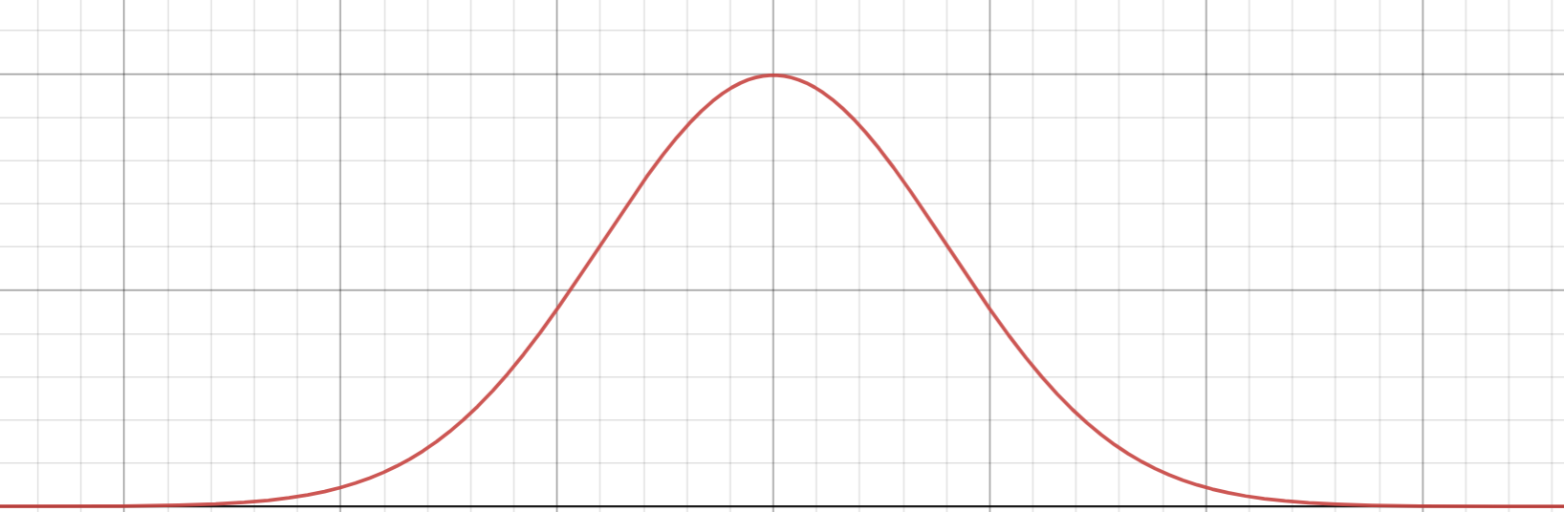
From point to uncertainty estimation
In M5 accuracy competition, the sales for each item are estimated. In the uncertainty competition, the previous estimation could be utilized to do the range prediction. Actually, the 0.5 quantile is exactly what we had estimated in the accuracy competition. We assume it is a normal distribution with the 0.5 quantile as the mean value and the other 8 quantiles can be estimated. In our project, Scipy toolkit is utilized to calculate the corresponding quantiles.
0.25 0.5 0.75
quantiles

Slide 18
Results of Uncertainty
/04
About
M5 Forecasting：Accuracy & Uncertainty

Slide 19
Result of M5 Forecasting - uncertainty
Methods | Public score | Private score
LGBM model (from accuracy to uncertainty) | 0.05561 | 0.30780
LSTM with Quantile Regression | 0.51769 | 0.49638
NNs with Quantile Regression | 0.11617 | 0.20020

Slide 20
Result Analysis
The model shows the worst result, some reasons as followed:
1. The loss of periodic feature. Since the input of the model is the sales of 14 consecutive days, which the sales in 15th day estimated is based on. However, although we had taken the calendar related features into account, but it still loses some periodic characteristics.
2. Using our prediction sales to do the further predicting, which means the error could be accumulated.
3. Model construction problem. It seems some more adjustment of the structure and parameters should be applied to avoid over-fitting problems.
Since in the accuracy competition, we got good grades by performing LGBM to do the estimation, the uncertainty estimation from accuracy got not bad results too.
However, we can not know the actual variance of the distribution. This kind of method can be a little tricky, since we test different parameters to get the best performance.
The neural network is fed with a large amount of data with multiple features and time series characteristics. Besides, we added dropout layers in the network structure to avoid over fitting. It effectively predict the future sales after iterative training. And it shows the best results among all of the methods.
from accuracy to uncertainty
LSTM with Quantile Regression
NNs with Quantile Regression

Slide 21
Further improvements
1. More feature engineering should be applied.
2. Neural network structure adjustment.

Slide 22
Thanks!
Group 4
LU Fei 20797386
XIONG Yi 20787642
ZHENG Hao 20797594

